Slide 1
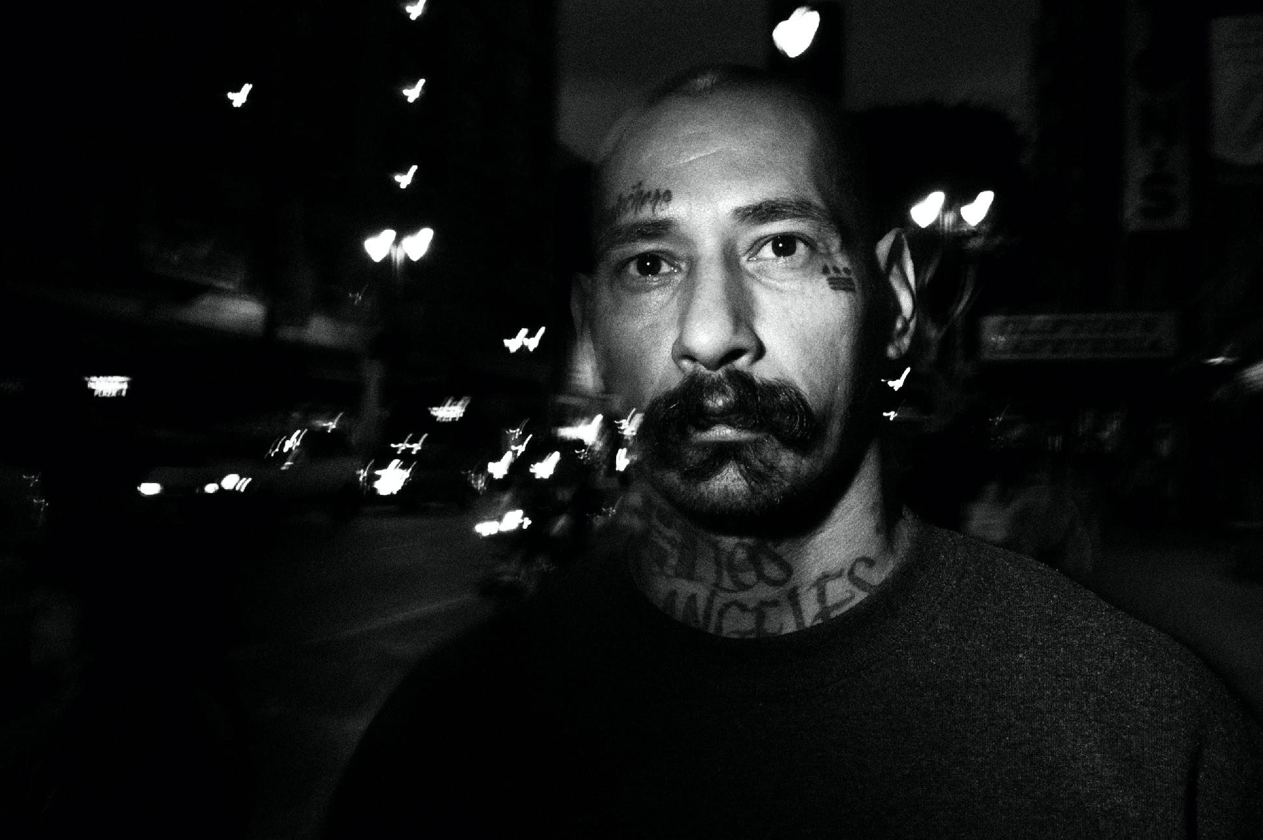
ERIC KIM CONQUER YOUR FEARS ONLINE WORKSHOP
MARK I / OPEN SOURCE

Slide 2
What Are Your Personal Fears?

Slide 3
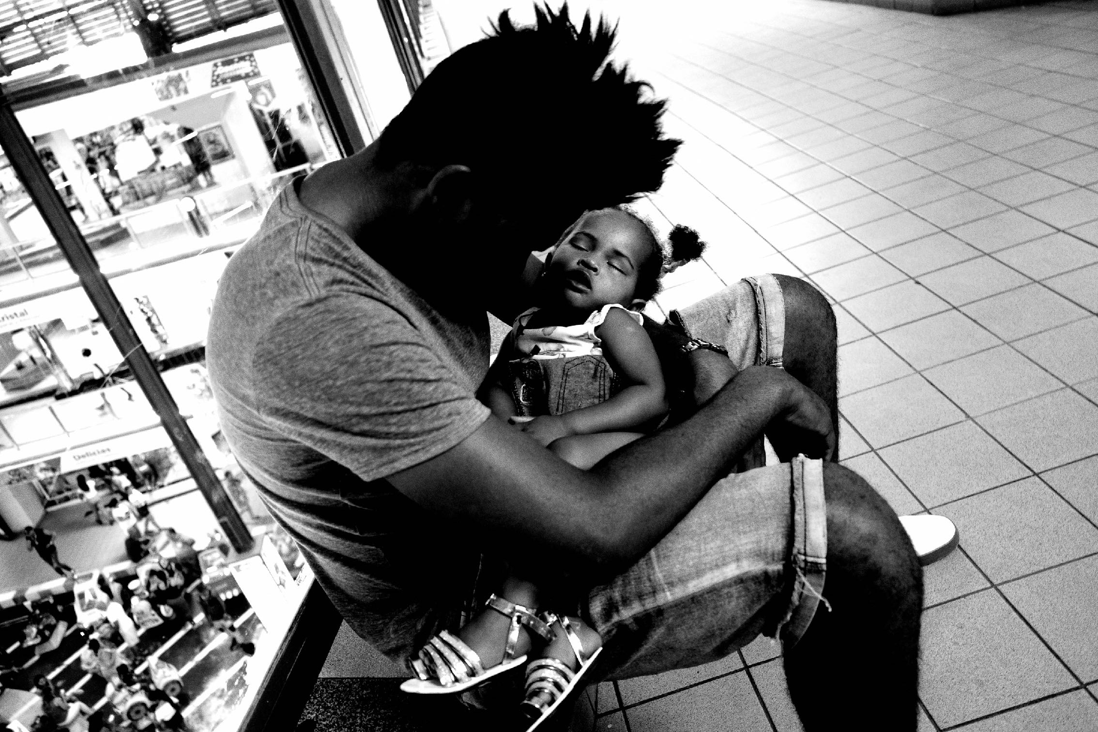
Is Fear Getting In Your Way from Achieving and Realizing Your Dreams?

Slide 4
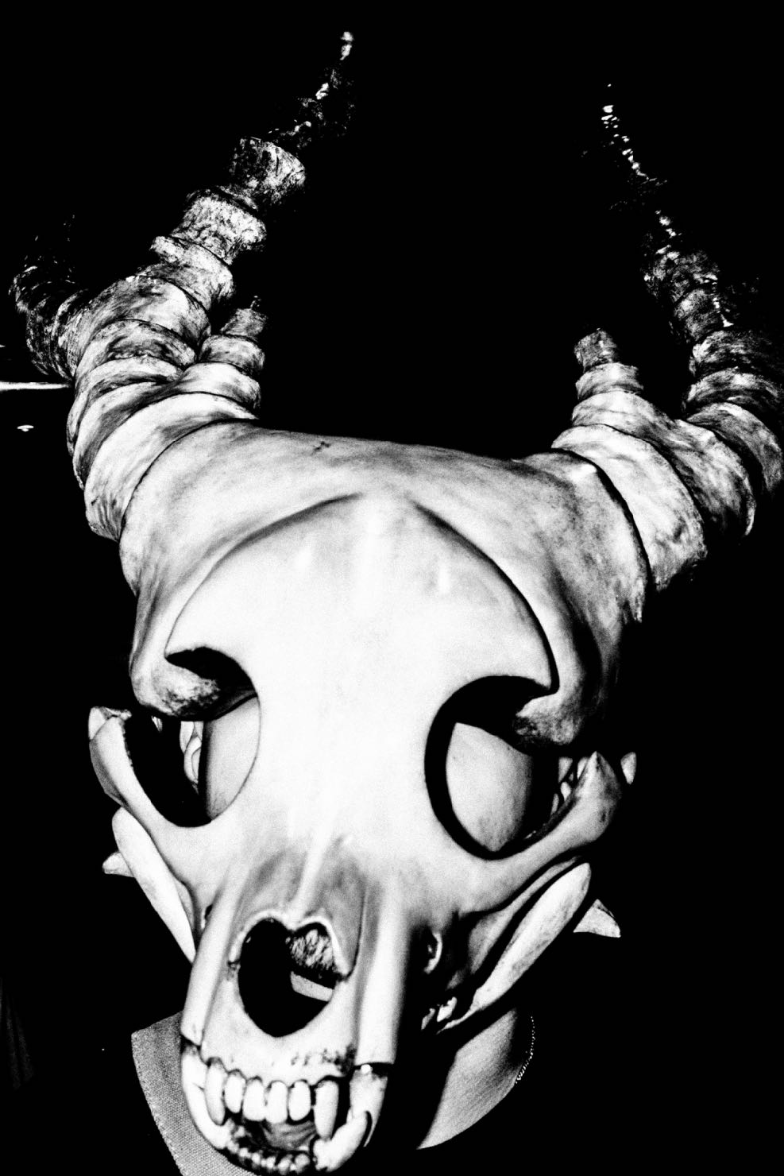
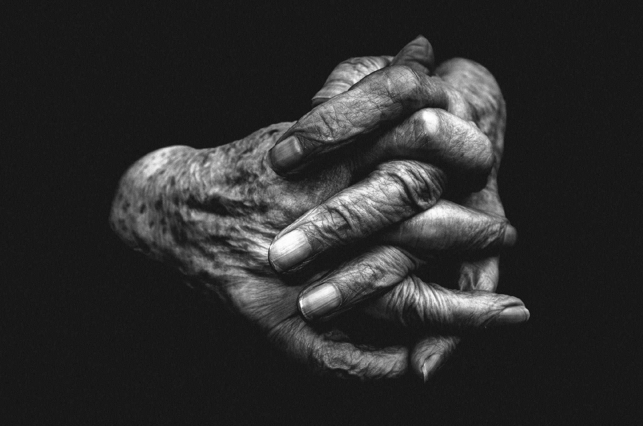
The Physiology of Fear

Slide 5
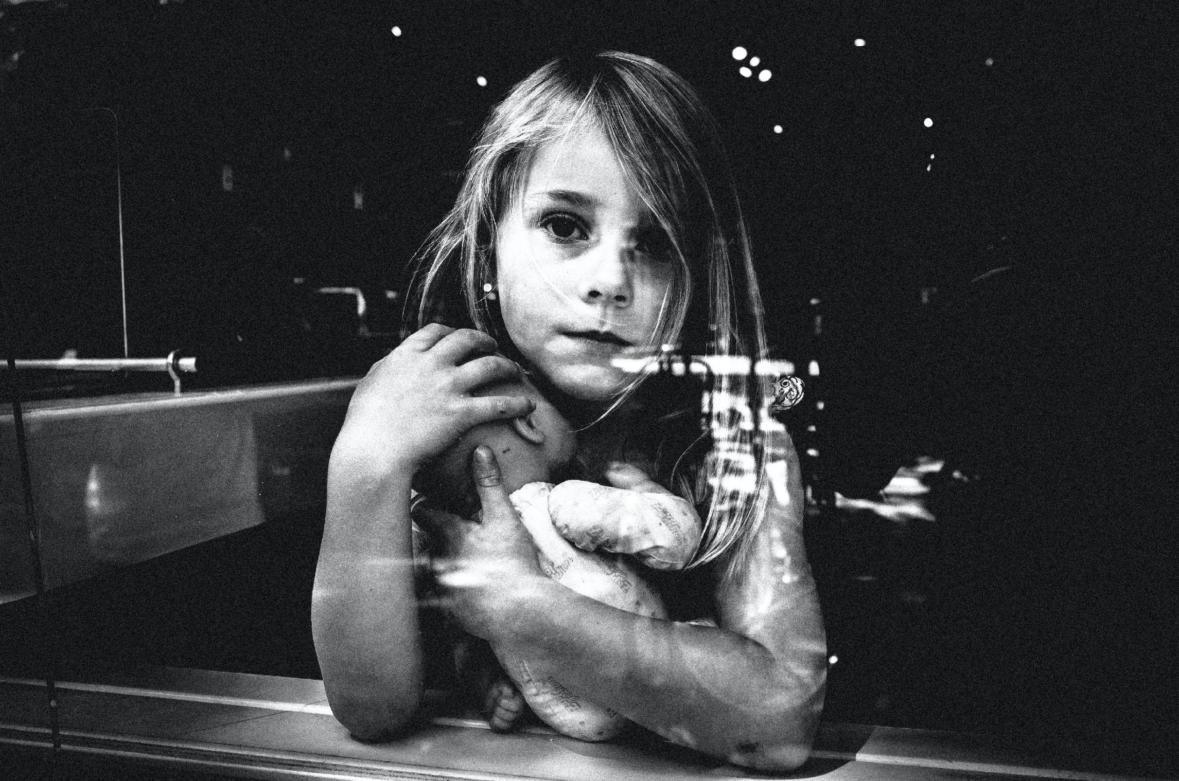
ETHICS vs FEAR

Slide 6
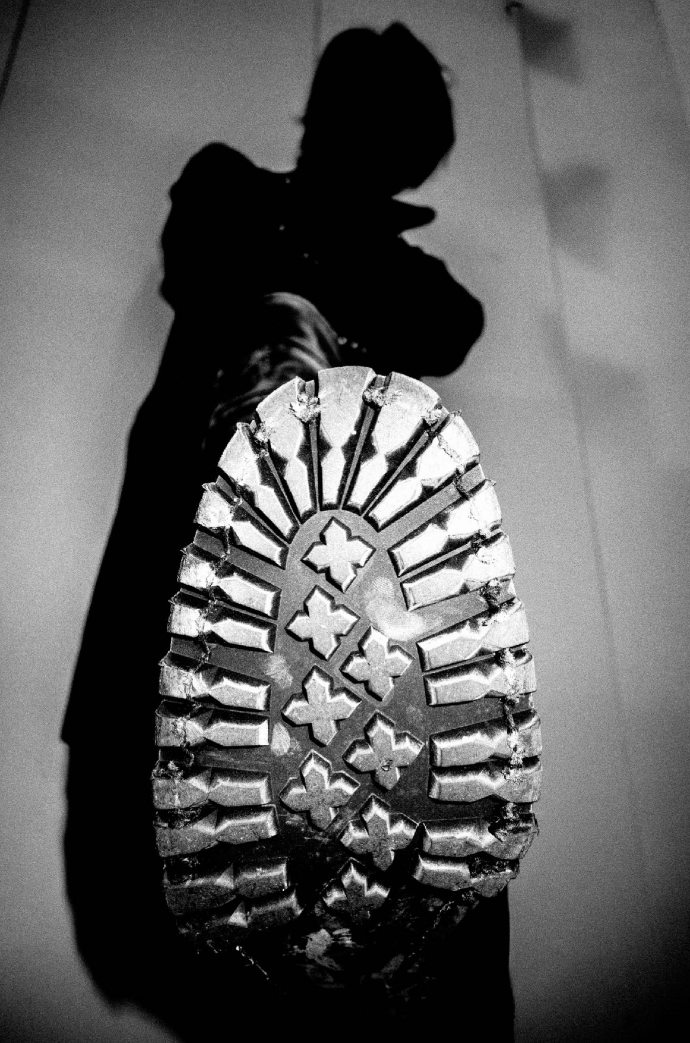
What is the Worst that Can Happen?

Slide 7
Socially-Distant Street Photography

Slide 8
STOICISM
All upside from life, no downside.

Slide 9
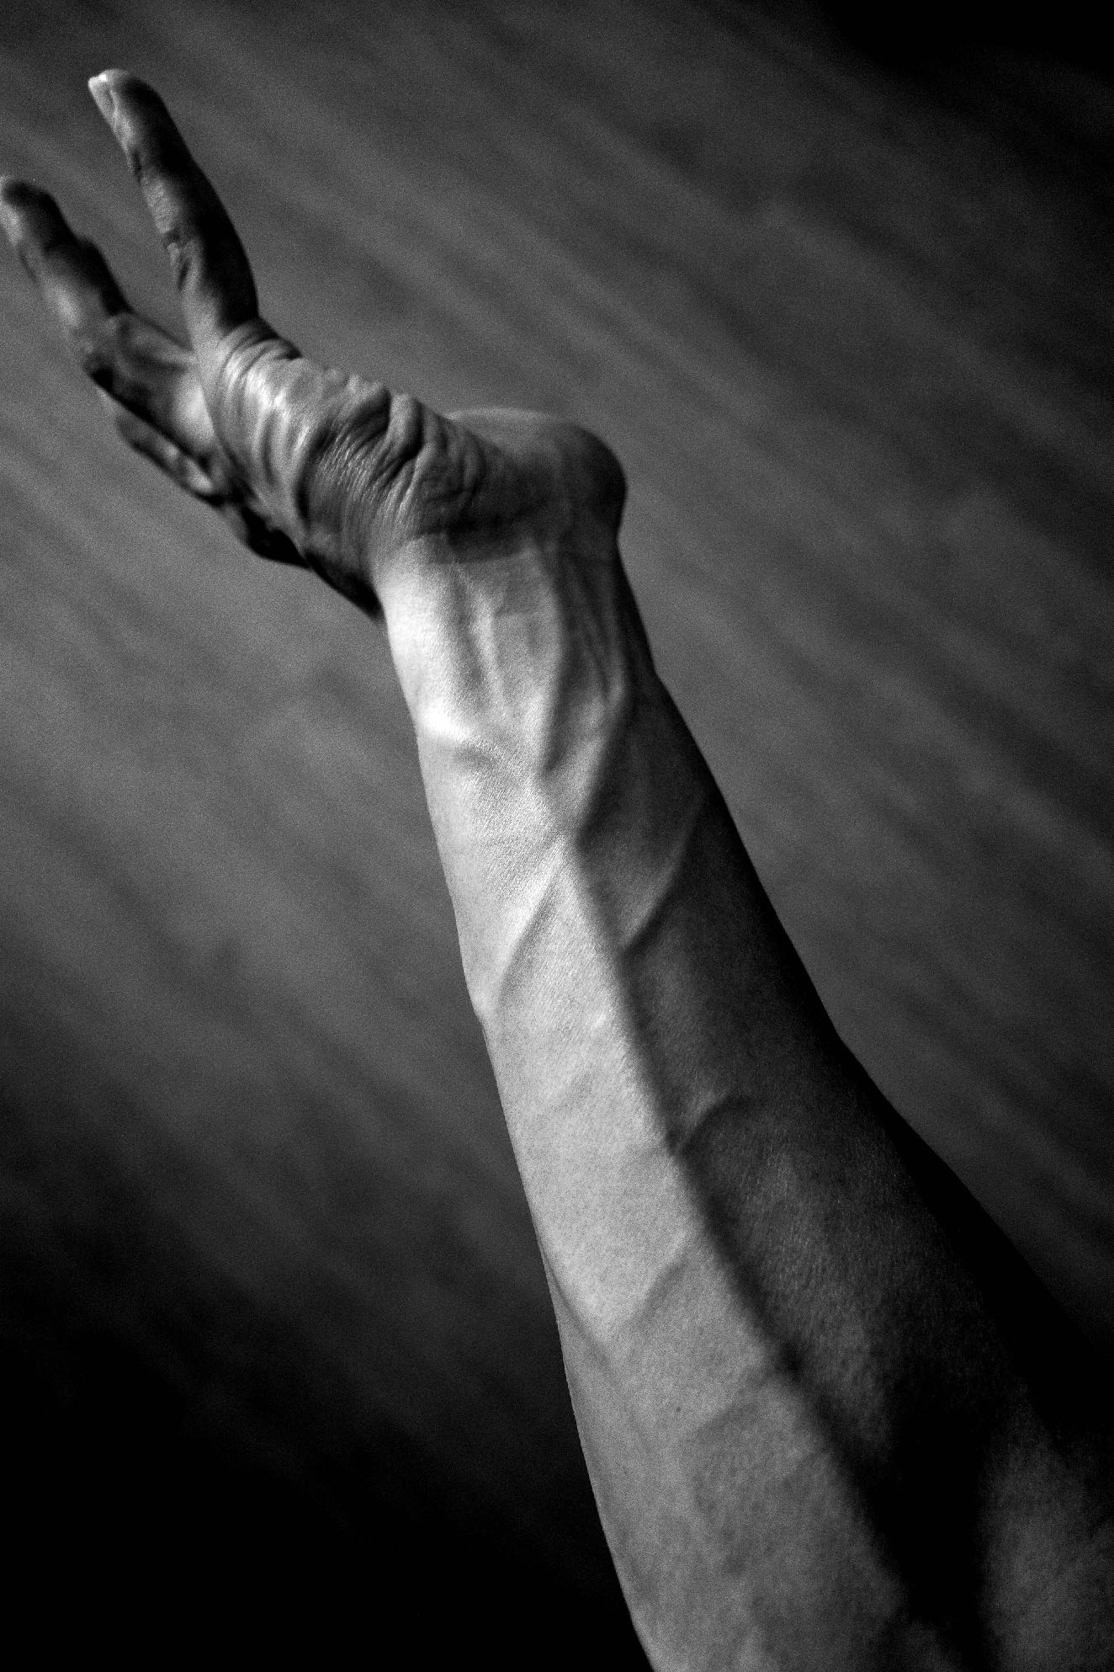
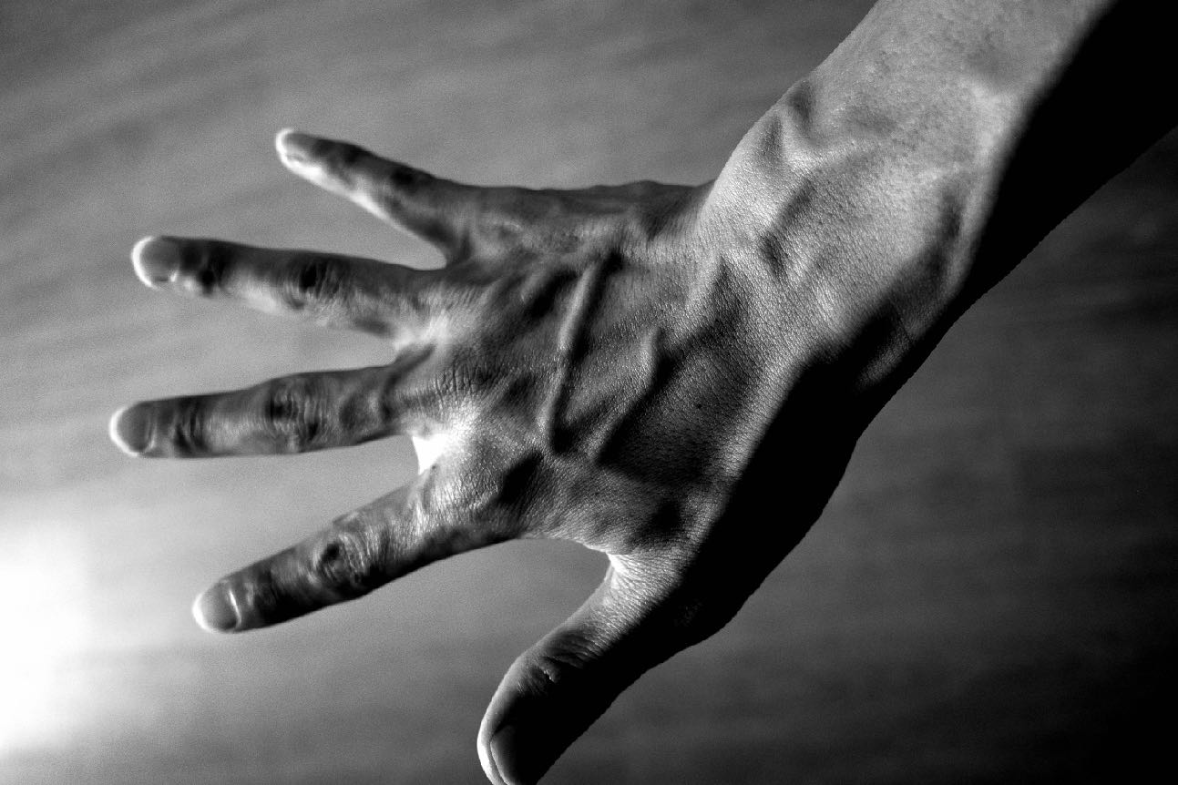
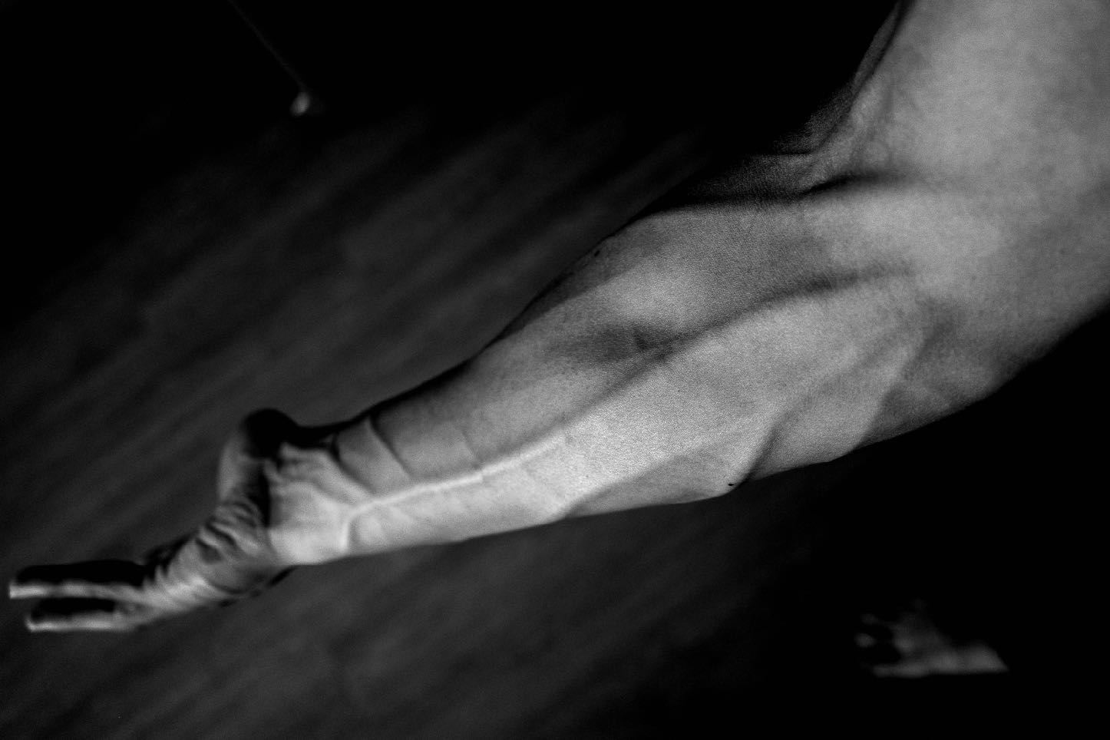

Slide 10
What is Fear?

Slide 11
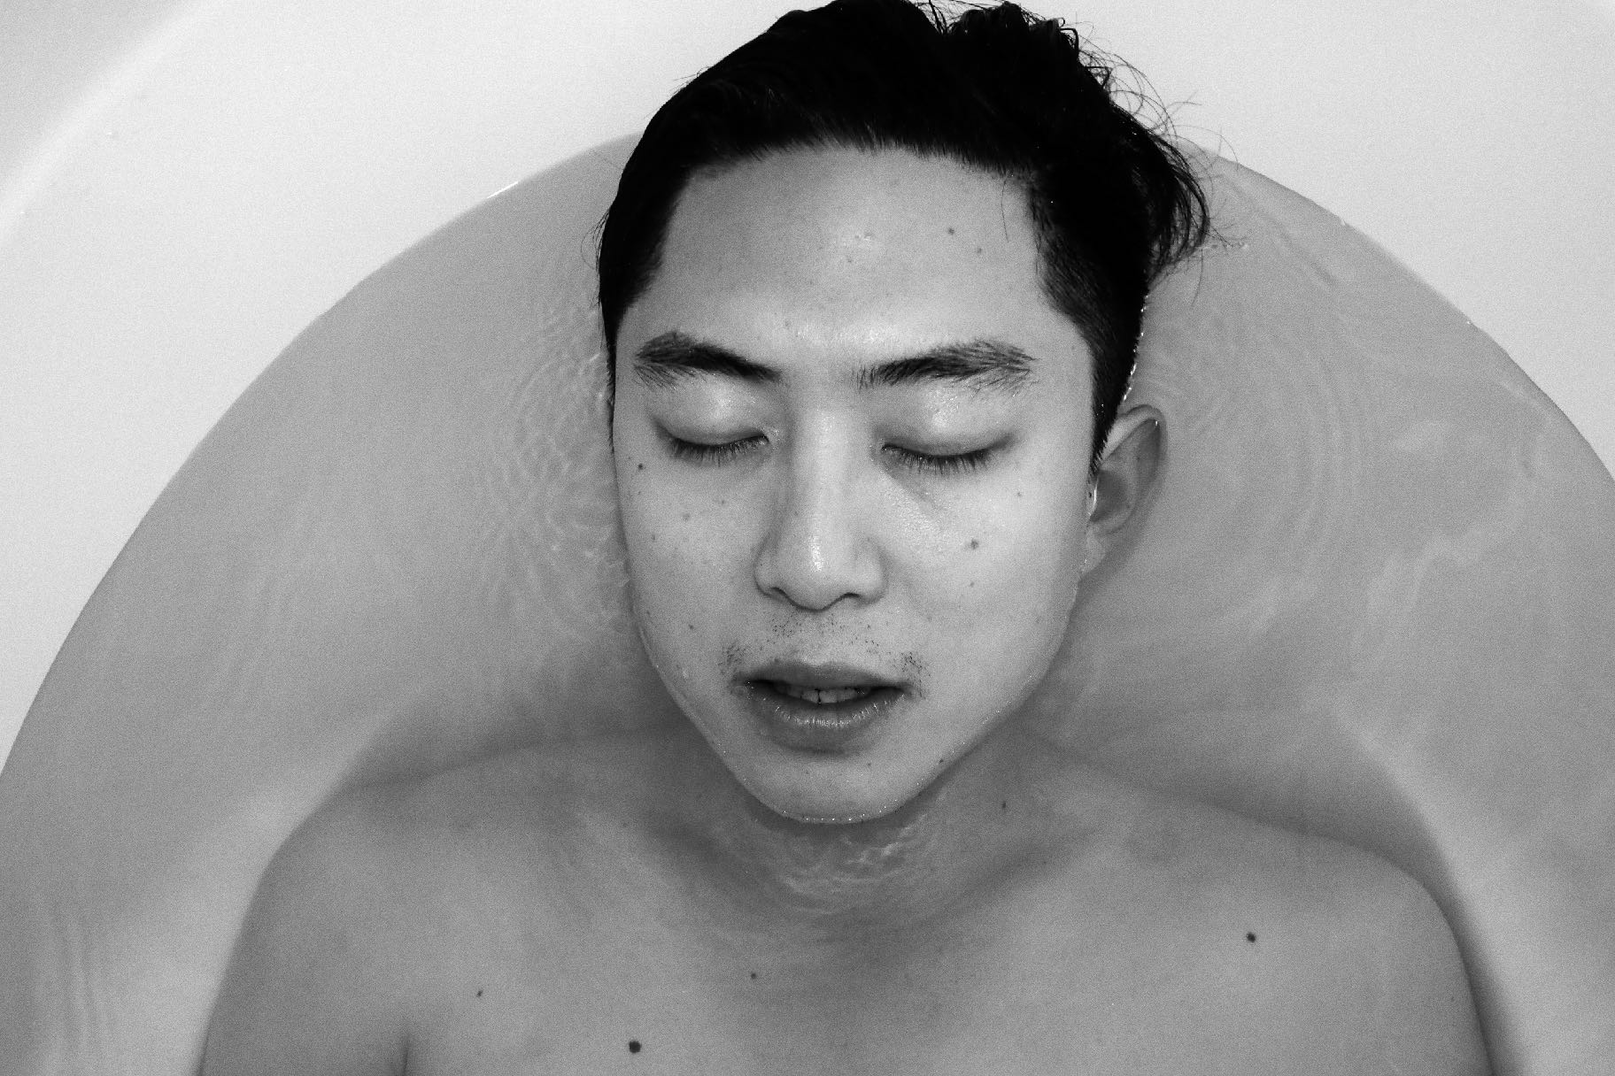
The Regret-Minimization Framework
“Imagine yourself at age 90 on your death-bed. What would have regretted NOT doing or attempting in life?”
- JEFF BEZOS

Slide 12
Practical Fear-Conquering Exercises

Slide 13
Do you love people in the flesh or the abstract?
Real life people vs People in the Abstract

